Slide 1
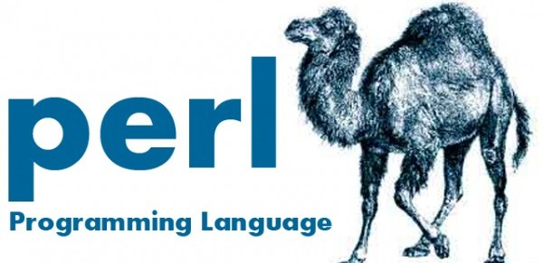
Perl Training - Session 2
Dr. Prabhakar PhD
Senior Integration Engineer
Decision Minds, Bengaluru.

Slide 2
Contents
Data Types (scalars, arrays and hashes)
Operators (mathematical, relational, Boolean)
Global and local variables
Conditional statements

Slide 3
Review: Components of Perl Script
Shebang line: Linux
Shebang line - Windows – not necessary
Path to Perl Interpreter
#!/usr/bin/perl
#!C:\Perl\bin\perl.exe
use strict;
use warnings;
use module-name;
#This is a program to understand the components
#of a Perl Script.
print “Practical Perl Made Easy\n”;
Helps to find typos in variable names
Helps to find errors in the code
Module Name (optional)
Comments
Ignored by Interpreter
Statements/Instructions
Perl file is either saved with the extension .pl or .plx
Statements end with semi colon.

Slide 4
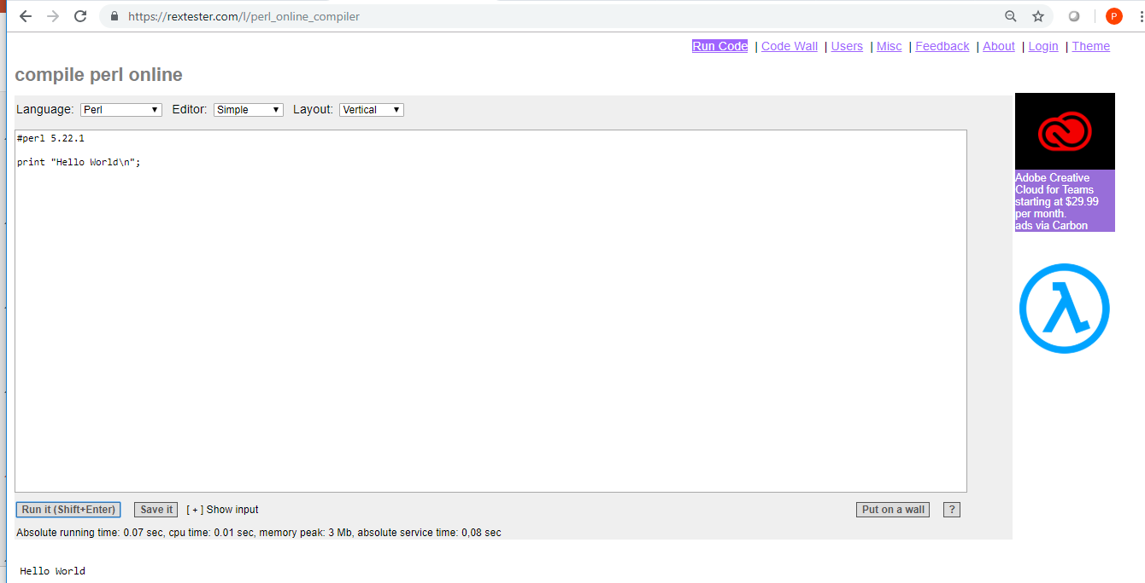
Practicing Perl online
https://rextester.com/l/perl_online_compiler

Slide 5
Perl Data Types
Scalars: Perl scalars are a single data item. They are simple variables, preceded by a ($) sign. A scalar can be a number, a reference (address of a variable) or a string.
Arrays: Perl arrays are an ordered list of scalars. They are preceded by (@) sign and accessed by their index number which starts with 0.
Hashes: Perl hashes are an unordered collection of key-value pairs. They are preceded by (%) sign and accessed using keys.

Slide 6
Perl Data Types - Variables
Variable is just a container that stores data of any data types: int, float, character, string. Declaration of data types is not essential for using the variables.
They can be manipulated throughout the program. When variables are created they reserve some memory space.
Assignment operator “=“ is used for storing the values to the variables.
$int=8;
$float=98.082;
$character=‘b’;
$string=“This is a string”;
Numeric/Integer assignment
Float assignment
Character assignment
String assignment

Slide 7
Perl Data Types - Local vs. Global Variables
If the scope of the variable is within the block of code, then it is known as local variable, declared with keyword my.
Variables that are directly used without the declaration(using my keyword) are accessible from every part of the program.
$age=28;
if (1<2)
{
my $age=25;
print “$age\n”;
}
print “$age\n”;
if (1<2)
{
$age=25;
}
print “$age\n”;

Slide 8
Quotes and Substitutions
Single-quotes ' ‘.
Double-quotes " " .
$x=10;
print('$x\n');
$x=10;
print("$x\n");

Slide 9
Scalars
We can define scalars in two ways.
First, we can declare and assign value together.
Second, we will first declare and then assign value to the scalar.
use strict;
use warnings;
#Declaring the variable first and then assigning value
my $city;
$city = "Delhi";
print $city;
#Declaring and assigning value together
my $color = "Red";
print $color;

Slide 10
Scalar Operations
String Context
use strict;
use warnings;
my $x=5;
print "Value of x is: $x\n";
my $y=4;
print "Value of y is: $y\n";
print $x+$y;
print "\n";
print $x.$y;
print "\n";
print $x-$y;
use strict;
use warnings;
my $x = "5";
my $y = "2cm";
print $x + $y;
print "\n";
print $x . $y;
Perl automatically converts strings to numbers and numbers to strings as per the requirement.

Slide 11
Operators
Arithmetic
+ Addition
- Subtraction
* Multiplication
/ Division
** Exponents
% Modulus
Assignment
+= Addition ($a += 10)
-= Subtraction ($a -= 10)
*= Multiplication ($a *= 10)
/= Division ($a /= 10)
%= Modulus ($a %= 10)
**= Exponent ($a **= 10)
Relational
==,eq Equal
!=,ne Not Equal
<,lt Less Than
>,gt Greater Than
<=,le Less Than or Equal
>=,ge Greater Than Equal
Logical
&&,and Associates two variables using AND
||,or Associates two variables using OR

Slide 12
Arithmetic
Assignment
use strict;
use warnings;
my $x = 5;
my $y = 2;
print "\nAddition\n";
print $x + $y;
print "\nSubtraction\n";
print $x - $y;
print "\nMultiplication\n";
print $x * $y;
print "\nDivision\n";
print $x/$y;
print "\nModulus\n";
print $x%$y;
print "\nExponent\n";
print $x**$y; ;
use strict;
use warnings;
print"\nAssignment\n";
$x = 5;
$x+=10;
print "Added: $x\n";
$x-=2;
print "Subtracted: $x\n";
$x*=10;
print "Multiplied: $x\n";
$x/=10;
print "Quotient: $x\n";
$x%=3;
print "Remainder: $x\n";

Slide 13
Relational
Logical
use strict;
use warnings;
$x=5;
if ($x == 5)
{print "Value is equal\n";}
if ($x < 10)
{print "Value is less than\n";}
if ($x > 3)
{print "Value is greater than\n";}
use strict;
use warnings;
$x=5;
if ($x == 5 && $x < 10)
{print "Value is equal to $x and is less than 10\n";}
if ($x == 5 || $x > 3 )
{print "Value is equal to $x and greater than 3\n";}

Slide 14
Arrays
Arrays are indexed collection of variables, prefixed with symbol @.
Accessing array elements can be done with a dollar sign ($) followed by element index within the square brackets after the name of the array.
Array variable is denoted by the @ symbol
@array = ( “Larry”, “Curly”, “Moe” );
To access the whole array, use the whole array
print @array; # prints : Larry Curly Moe
Notice that you do not need to loop through the whole array to print it
Perl does this for you

Slide 15
Arrays
Array Indexes start at 0 !!!!!
To access one element of the array : use $
Why? Because every element in the array is scalar
my @names = ("Foo", "Bar", "Baz");
print “@names[0]\n”;
print “@names[1]\n”;
print “@names[2]\n”;
print “@names[3]\n”;
Question:
What happens if we access $array[3] ?
Answer1 : Nothing is printed

Slide 16
Arrays
Arrays size can be determined using the scalar context on the array.
@array = (1,2,3);
print "Size: ",scalar @array,"\n";
Note another way to find the number of elements in the array:
$array_size = @array; print $array_size;
$array_size now has 3 in the above example because there are 3 elements in the array
To find the index of the last element in the array
print $#array; # prints 2 in the previous # example

Slide 17
Numeric Array Sorting
Perl has a built in sort function.
Two ways to sort:
Sort ARRAY
Sort USERSUB ARRAY
The <=> and cmp operators make creating sorting subroutines very easy
@unsortedArray = (3, 10, 76, 23, 1, 54);
@sortedArray = sort numeric @unsortedArray;
print “@unsortedArray\n”; # prints 3 10 76 23 1 54
print “@sortedArray\n”; # prints 1 3 10 23 54 76
sub numeric
{
return $a <=> $b;
}
# Numbers: $a <=> $b : -1 if $a<$b , 0 if $a== $b, 1 if $a>$b

Slide 18
String Array Sorting
#!/usr/local/bin/perl -w
@unsortedArray = (“Larry”, “Curly”, “moe”);
@sortedArray = sort { lc($a) cmp lc($b)} @unsortedArray;
print “@unsortedArray\n”; # prints Larry Curly moe
print “@sortedArray\n”; # prints Curly Larry moe
# Strings: $a cpm $b : -1 if $a<$b , 0 if $a== $b, 1 if $a>$b

Slide 19
Array Transformation
Transformation of strings to arrays can be done using the split() function.
$var_string = "All,That,Glitters,Is,Not,Gold";
# transform above strings into arrays.
@string = split(‘,', $var_string);
print "$string[3]\n"; # This will print Glitters
Similarly we can transform an array into strings using join() function.
$string1 = join( ',', @string );
# This will print All,That,Glitters,Is,Not,Gold
Notes:
Arrays are very useful when handling files in perl, we can directly read the contents of the file and store it in an array and do what ever operations with the elements of the array.

Slide 20
Array Manipulation
Adding and removing elements in array
Push - adds the string or array to the end of array
Pop - removes the last element in the array
use strict;
use warnings;
my @names = ('Foo', 'Bar', 'Baz');
print "@names\n";
my $last_one = pop @names;
print "$last_one\n";
print "@names\n";
use strict;
use warnings;
my @names = ('Foo', 'Bar');
print "@names\n";
push @names, 'Moo';
print "@names\n";
my @others = ('Darth', 'Vader');
push @names, @others;
print "@names\n";

Slide 21
Array Manipulation
Adding and removing elements in array
Shift - removes the first element in the array
Unshift - adds the string or array to the beginning of array
use strict;
use warnings;
my @names = ('Foo', 'Bar', 'Moo');
my $first = shift @names;
print "$first\n";
print "@names\n";
use strict;
use warnings;
my @names = ('Foo', 'Bar');
unshift @names, 'Moo';
print "@names\n";
my @others = ('Darth', 'Vader');
unshift @names, @others;
print "@names\n";

Slide 22
Hashes
Hashes are nothing but associative array, but the only difference is that there are key for each elements in the hashes.
Using the hash key we can manipulate the contents of the hashes.
Keys are nothing by references to the elements stored in the hashes.
Arrays are ordered, and you access an element of an array using its numerical index. Hashes are un-ordered and you access a value using a key which is a string.

Slide 23
Hashes Example
#!/usr/bin/perl
# defines country => language hash
my %langs = ( England => 'English',
France => 'French',
Spain => 'Spanish',
China => 'Chinese',
Germany => 'German');
# get language of England
my $lang = $langs{'England'}; # English
print($lang,"\n");

Slide 24
Conditional Statements
If statement
Syntax: if (condition) statement
use strict;
use warnings;
print “If condition example\n\n";
my $age = 24;
if ($age >= 18)
{
print "In most countries you can vote.\n";
}
Notes:
Conditional statements are the bread and butter of the programmers, they are useful for checking the conditions

Slide 25
Conditional Statements
If else statement
Syntax: if (condition) statement else statement
use strict;
use warnings;
print "If else condition example\n\n";
my $age = 16;
if ($age >= 18)
{
print "Yes you can vote\n";
}
else
{
print "In most countries you can vote.\n";
}
Notes:
Conditional statements are the bread and butter of the programmers, they are useful for checking the conditions

Slide 26
Conditional Statements
If elsif else statement
Syntax: if (condition) elsif (condition) statement else statement
use strict;
use warnings;
print "If elsif else condition example\n\n";
$a = 100;
# check the boolean condition using if statement
if( $a == 20 ) {
# if condition is true then print the following
printf "a has a value which is 20\n";
} elsif( $a == 30 ) {
# if condition is true then print the following
printf "a has a value which is 30\n";
} else {
# if none of the above conditions is true
printf "a has a value which is $a\n";
}
Notes:
Conditional statements are the bread and butter of the programmers, they are useful for checking the conditions

Slide 27
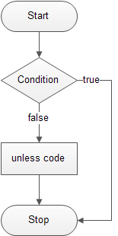
Conditional Statements
unless statement
Syntax: unless (condition) statement
use strict;
use warnings;
print “unless else condition example\n\n";
my $a = 10;
my $a = 10;
unless($a <= 0){
print("a is greater than 0\n")
}
Notes:
Conditional statements are the bread and butter of the programmers, they are useful for checking the conditions

Slide 28
Conditional Statements
unless else statement
Syntax: unless (condition) statement else statement
use strict;
use warnings;
print “unless condition example\n\n";
my $a = 10;
unless($a >= 0){
print("a is less than 0\n");
}else{
print("a is greater than or equal 0\n");
}
Notes:
Conditional statements are the bread and butter of the programmers, they are useful for checking the conditions

Slide 29
Conditional Statements
unless elsif else statement
Syntax: unless (condition) elsif (condition) statement else statement
use strict;
use warnings;
my $a = 1;
unless($a > 0){
print("a is less than 0\n");
}elsif($a == 0){
print("a is 0\n");
}else{
print("a is greater than 0\n");
}
Notes:
Conditional statements are the bread and butter of the programmers, they are useful for checking the conditions

Slide 30
Conditional Statements
Ternary Operator
Syntax:
CONDITION ? EVALUATE_IF_CONDITION_WAS_TRUE : EVALUATE_IF_CONDITION_WAS_FALSE
use strict;
use warnings;
$apples=3;
$oranges=1;
print "I have $apples ", $apples==1?"apple":"apples", "\n";
print "I have $oranges orange", $oranges==1?"":"s", "\n";
Notes:
Conditional statements are the bread and butter of the programmers, they are useful for checking the conditions

Slide 31
Coming up in session 3
Control Statements (loops)
Functions - Subroutines
File Handling
Regular Expressions

Slide 32
Thank you

